Slide 1
The World Federation of Occupational Therapists report to COTEC October 2014 Samantha Shann Vice President Finance

Slide 2
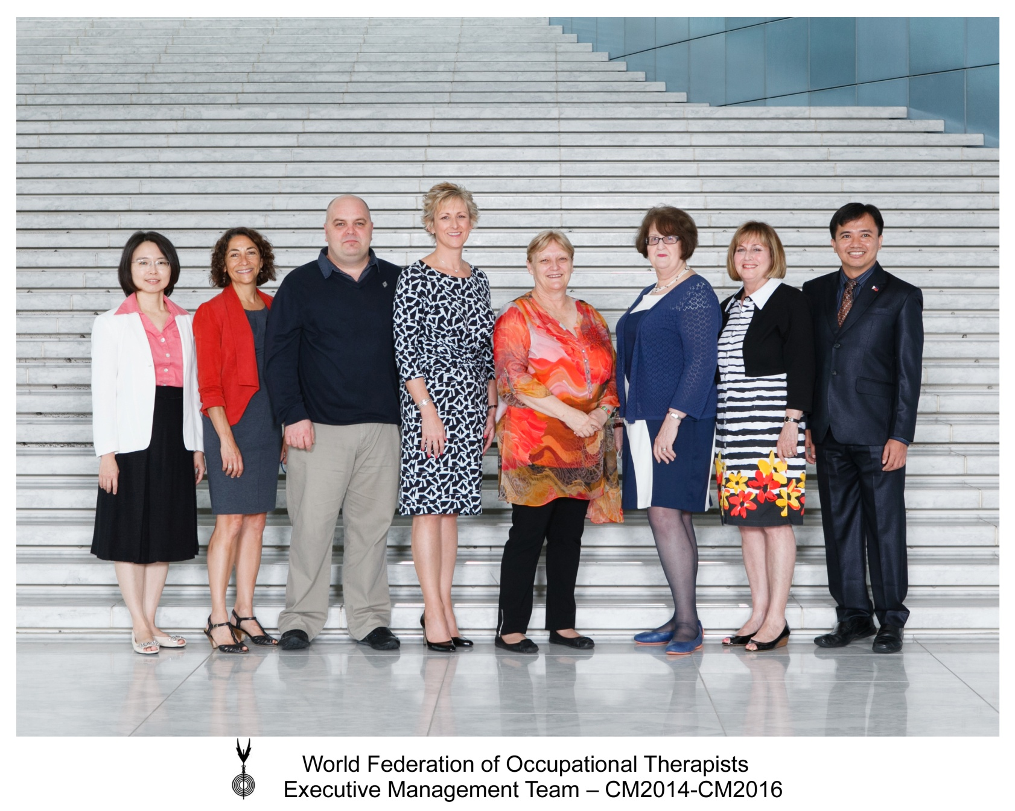

Slide 3
STRUCTURE
WFOT Council
Executive Management Team
Education
Standards and Quality
Ongoing Functions
Projects
Executive Programmes
Practice Development
Ongoing Functions
Projects
Projects
Ongoing Functions
Projects
Ongoing Functions
Projects
Meets every year
Meets every two years
Two year work cycles
Ongoing Functions
Research

Slide 4
HUMAN RESOURCES PROJECT
Demographic scan of WFOT Member Organisations
Undertaken every two years, most recent in 2014
99% response rate
Full presentation is available from the WFOT website www.wfot.org

Slide 5
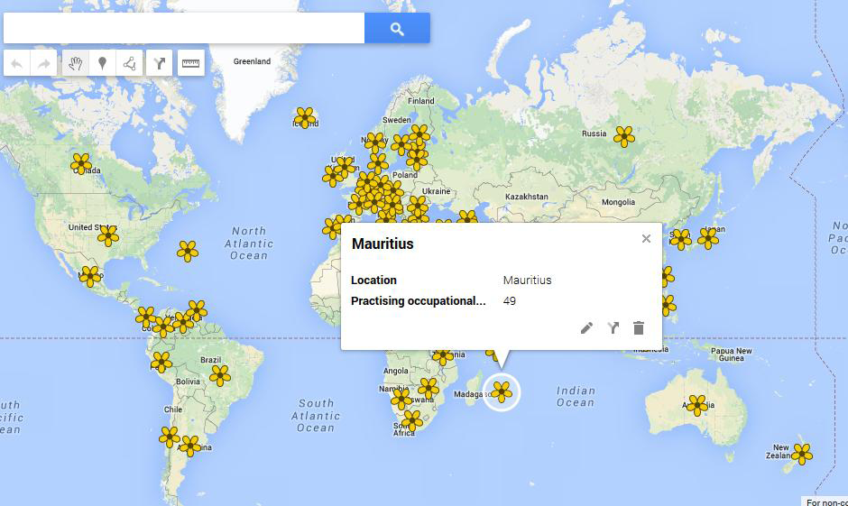
HUMAN RESOURCES PROJECT 2014
Interactive Google map: http//:google.gl/YadqYM

Slide 6
SURVEY
https://www.surveymonkey.com/s/otion2014
please forward to others
the deadline for responses is 15th November 2014

Slide 7
KEY RELATIONSHIPS
Official relations with the World Health Organization (WHO) since 1959
WFOT and WHO have an active working relationship both regionally and internationally. Collaborations include:
World Report on Disability
Community Based Rehabilitation
Mental Health
Disability Research
Healthy Workplaces
Wheelchair Provision
Education

Slide 8
WORKING WITH WHO
Liaise with WHO
http://www.who.int

Slide 9
THE BONE & JOINT DECADE 2010-2020
The “Call for Action to Invest in Musculoskeletal Health and Control the Burden of Musculoskeletal Conditions” calls on health policy makers at national and regional levels and the WHO for explicit plans to deal with the large and growing burden of musculoskeletal conditions and injuries on individuals and society. You can find the Call for Action at: http://bjdonline.org/e-petition

Slide 10
WHO EUROPE – HEALTH 2020
European health policy framework which aims to support action across government and society to: “significantly improve the health and well-being of populations, reduce health inequalities, strengthen public health and ensure people-centred health systems that are universal, equitable, sustainable and of high quality”.
Liaise with WHO

Slide 11
WHO EUROPE – HEALTH 2020
Liaise with WHO
Investing for healthy people and empowering communities.
Strong emphasis on people and people-centred policies and systems through a life course approach with special concern for the disadvantaged.

Slide 12
WHO EUROPE – HEALTH 2020
• The right to health and universal coverage
• People and communities
• Tackling inequities
• Whole of society and whole of government approaches
• Health systems and public health capacities and performance
• Integrated approaches for tackling public health challenges
• Leadership sustainable and of high quality
Liaise with WHO

Slide 13
WHO EUROPE – HEALTH 2020
Liaise with WHO
Related documents & work:
Action plan for mental health
Action plan for healthy ageing
Action plan for child and adolescent health
Clear focus on non communicable diseases
Integrated health care systems

Slide 14
WHO EUROPE – HEALTH 2020
Liaise with WHO
Actions:
WFOT & COTEC will be part of the main agenda for the 65th Regional Committee Europe
We need examples of what OT’s across Europe are dong to meet the outcomes & targets of Health 2020

Slide 15
WHO EUROPE – HEALTH 2020
Actions:
case study format will be emailed to national associations once received from WHO
can start now by familiarising ourselves with the relevant WHO documents
http://www.euro.who.int
Copies of WFOT Statements can be found at: http://www.wfot.org/AboutUs/InternationalLiaison/InternationalLiaisonArticles.aspx
Liaise with WHO

Slide 16
PROMOTION
World Occupational Therapy Day – 27th October
World Occupational Therapy Day was first launched on 27th October 2010. Since then, it has become an important date in the occupational therapy calendar to promote and celebrate the profession internationally
What are you doing this year?

Slide 17
RESOURCES - COMMUNICATION
www.wfot.org
www.facebook.com/thewfot
@thewfot
www.youtube.com/thewfot

